Slide 1

Housing Prices
Alexander Wood
Notes:
Line spacing + Page numbers

Slide 2



Introduction
01
This presentation aims to show the most prominent factors involved in housing prices in order to advise investment in property using data sourced from King County housing sales.

Slide 3
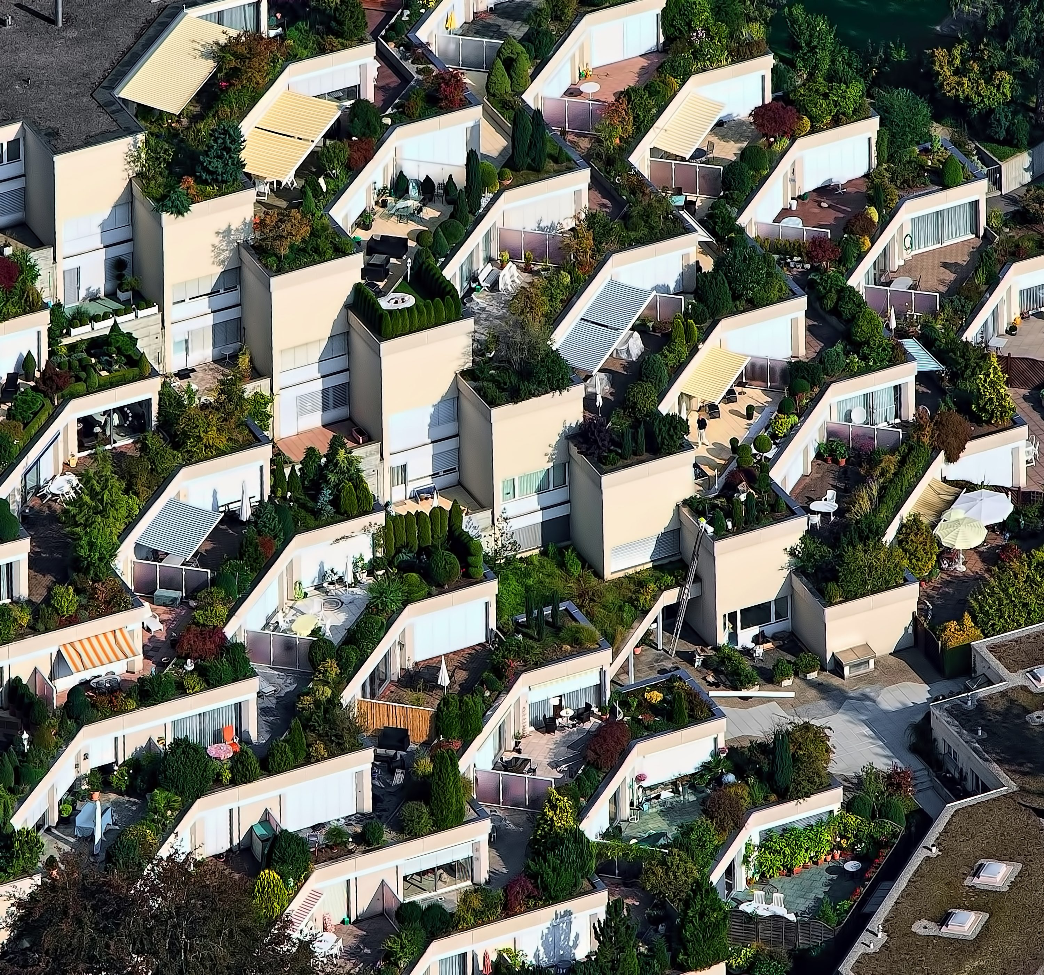


Three Factors of Growth
Square Footage of Living Area
The Square Footage of Neighbors Living Area
The grading given by the King County grading system

Slide 4
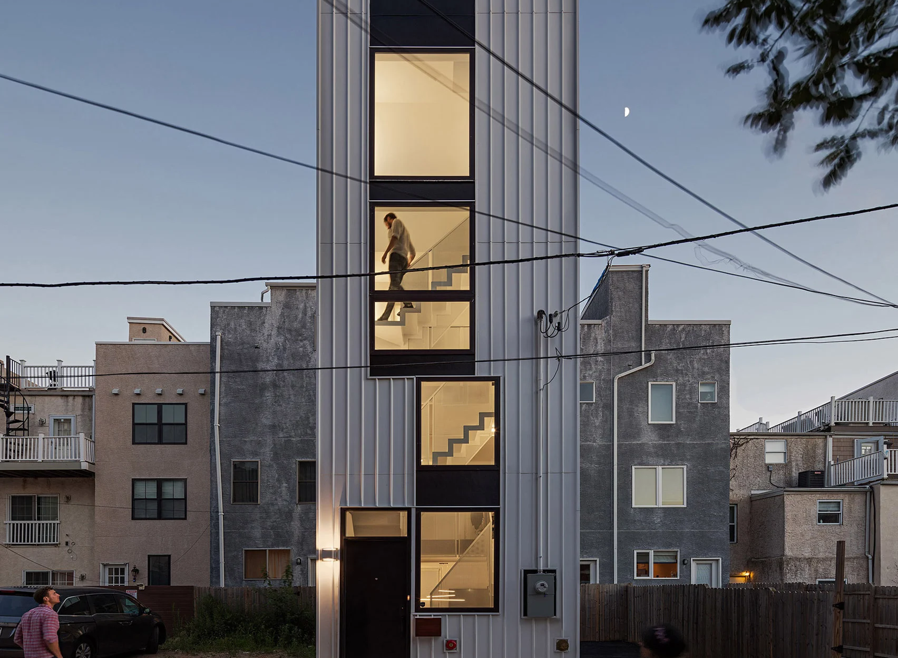

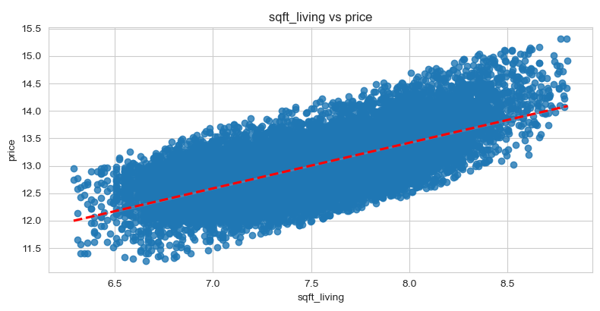
Size of the Living Area

Slide 5
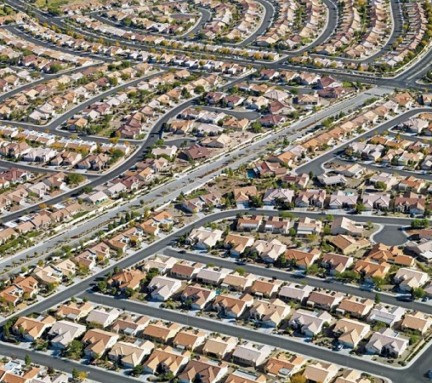
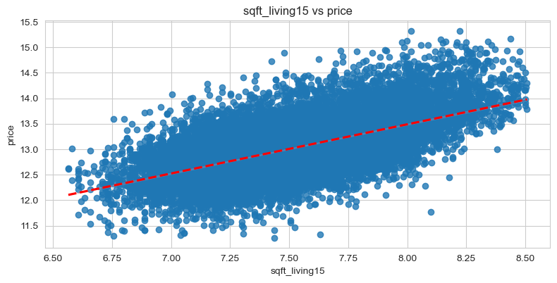
Size of Neighbors Living Area

Slide 6
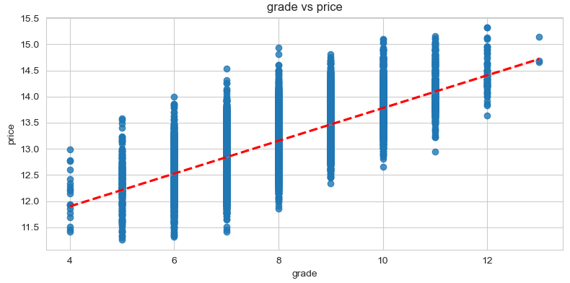

Grading System

Slide 7


